Slide 1
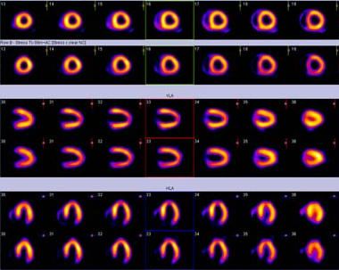
Myocardial stunning and hibernation

Slide 2
VIABILITY

Slide 3
CORONARY ARTERY DISEASE
ACUTE CORONARY SYNDROME
Undergo revascularisation procedures
Improved survival
Increased number of patients with residual LV dysfunction undergoing progressive LV remodeling and congestive heart failure

Slide 4
ADD TO THIS
1. rising age of our population
2. Higher prevalence of comorbidities, eg., DM-2
Typically, these patients have
multivessel disease,
increased LV volumes, and
variable degrees of regional or global systolic dysfunction
Among these patients, coronary revascularization may lead to symptomatic and prognostic improvement, and these clinical benefits are accompanied by evidence of reverse LV remodeling.

Slide 5
In the early 1980s, Rahimtoola et al reviewed the results of coronary bypass surgery trials and identified patients with CAD and chronic LVD that improved upon revascularization.
CORNERSTONE FOR ALL FUTURE STUDIES
CASS (coronary artery surgery study ) REGISTRY
Patients with LVEF < 35% involved 651 patients.
The five year survival was significantly better in surgical patients (68%) than in the medical group (54%).
The contrast was even more in patients with LVEF < 26% whose five year survival was 63% with surgery, but 43% with medical treatment

Slide 6
Thus came the concept of myocardial viability and with it came the new terms such as hibernation and stunning

Slide 7
THE MYOCARDIAL RESPONSE TO ISCHEMIC INJURY

Slide 8
Onset of severe ischemia
Within seconds
aerobic changes to anaerobic metabolism
Decrease in the production of high-energy phosphates, namely adenosine triphosphate (ATP) and phosphocreatine (PCr)
Ultrastructural changes occur -
Mitochondrial swelling,
Loosening of intercellular attachments,
The presence of small, lipid-rich amorphous mitochondrial densities,
Dilation of the sarcoplasmic reticulum,
Disaggregation of SR polysomes, and
Myofibrillar relaxation

Slide 9
within 1 min of acute onset
The myocardium is functionally sensitive to ischemia and will exhibit marked contractile dysfunction
HOWEVER, these ultrastructural defects are entirely reversible if reperfusion occurs within 20–40 min.

Slide 10
Irreversible Injury
Begins in the subendocardial tissue and progresses towards the
subepicardium.
In humans, it may take as long as 6–12 hr for complete infarction of the myocardium at risk
the necrotic changes are usually evident, about 4–12 hr after onset
This may include the denaturation of cytoplasmic proteins, swelling, and enzymatic digestion of organelles and the sarcolemma.

Slide 11
Viable myocardium must have the following characteristics
The ability to generate HEP (PCr and ATP)
Have an intact sarcolemma, in order to maintain ionic/electrochemical gradients, and
Have sufficient perfusion, both for the delivery of substrates and O2 and for the adequate washout of potentially noxious metabolites
? contractility.

Slide 12
There are two tissue states that exhibit sustained contractile dysfunction despite meeting the three criteria-
Stunned myocardium
&
Hibernating myocardium.

Slide 13
Myocardial stunning
First documented by Heyndrickx et al. in the mid- 1970s
Heyndrickx GR, Millard RW, McRitchie RJ, Maroko PR, Vatner
SF. Regional myocardial functional and electrophysiological alterations
after brief coronary artery occlusion in conscious dogs. J
Clin Invest 1975;56:978–985.

Slide 14
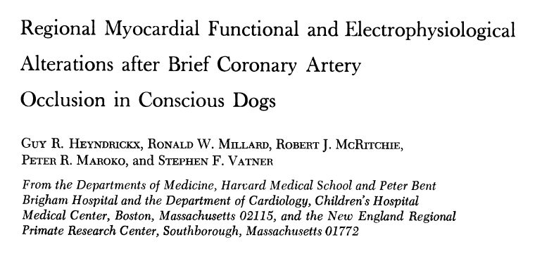
-They had concluded that brief periods of coronary occlusion resulted in prolonged depression of myocardial function in the ischemic zone.
-While regional electrograms return to normal within seconds and the coronary flow debt is repaid rapidly, functional derangement lasts for several hours.
Published October, 1975

Slide 15
The stunned myocardium: prolonged, postischemic ventricular dysfunction
Circulation 1982;66;1146-1149
E Braunwald and RA Kloner
Coined the term ‘‘myocardial stunning’’, for this phenomenon of ‘‘delayed recovery of regional myocardial contractile function after reperfusion despite the absence of irreversible damage and despite restoration of normal flow.

Slide 16
Features of stunning
Normal perfusion.
Depressed myocardial function.
Dissociation of usual relationship between subendocardial flow and function.
Reversible .
Function improves with inotropic agents.

Slide 17
Clinical Relevance
In the clinical setting stunning can occur-
1. Brief period of total coronary occlusion: pts with angina due to spasm
2. Global ischemia after cardiopulmonary bypass.
3. In combination : Subendocardium is infarcted and overlying subepicardium reversibly injured in MI
4. Following exercise in presence of a flow limiting stenosis
5. Ischemic bout that is induced by PCI

Slide 18
Pathogenesis of stunning
Earlier
loss of and reduced ability to synthesize high-energy phosphates,
Impairment of microvascular perfusion,
impairment of sympathetic neural responsiveness,
reduction in the activity of creatine kinase,
Presently
There are 2 major hypothesis for myocardial stunning:
a oxygen-free radical hypothesis and
a calcium overload hypothesis
Time-course of myocardial stunning
-Dysfunction may persist for hours or for as long as 6 weeks post-insult
-Both the duration and severity of ischemia determine the duration
of post-ischemia/reperfusion dysfunction

Slide 19
Mechanism of contractile dysfunction in stunning
Normal cardiac contraction depends on the maintenance of calcium cycling and homeostasis across the mitochondrial membrane and sarcoplasmic reticulum during each cardiac cycle.
Brief ischemia followed by reperfusion-→ accumulation of calcium and a partial failure of normal beat to beat calcium cycling -→ damages Ca²⁺ pump and ion channels of the sarcoplasmic reticulum.
This results in the electromechanical uncoupling of energy generation from contraction that characterizes myocardial stunning.

Slide 21
Hibernating Myocardium
Hibernating myocardium is a state of persistently impaired myocardial and left ventricular function at rest due to reduced coronary blood flows.
It can be defined as an exquisitely regulated tissue successfully adapting its activity to prevailing circumstances.
Characterstics-
Episodic and/or chronically reduced blood flow, which is directly responsible for the decrease in the myocardial contractile function.
Tissue ischemia and resultant remodeling without necrosis
Residual contractile reserve in response to inotropic stimulation (in at least half of clinical cases).
Recovery of contractile function after successful revascularization.

Slide 22
Mechanism of hibernation

Slide 23
Natural history of hibernation

Slide 24
Notes:
Hibernating and stunned myocardium. A, Brief episode of ischemia caused by thrombosis and/or vasoconstriction. B, Episode of silent ischemia caused by recurrent thrombosis and/or vasoconstriction. In this case, each episode is followed by a brief period of stunning (flow-function mismatch). C, Hibernation in a patient with severe fixed coronary stenosis. Function is downregulated to match flow and recovers immediately after flow is restored. D, This is more likely to be a real situation in a patient with severe coronary stenosis. It is more likely that coronary flow will fluctuate continuously because of severe epicardial stenosis and a loss of local autoregulation. Thus, myocardium may downregulate its function to a low level to achieve a metabolic balance between demand and supply. In many situations (eg, exercise, stress, patient with a history of unstable angina), this balance may be continuously upset by recurrent reduction of flow followed by stunning. In these situations, a deficit in function results from a complex combination of hibernation, ischemic dysfunction, and stunning.

Slide 25
IDENTIFYING VIABLE MYOCARDIUM

Slide 26
Key non invasive methods to identify viability
ECG : gives little information
Echocardiography
Single Photon Emission Computed Tomography
Positron Emission Tomography
Magnetic Resonance Imaging

Slide 27
Characteristics of dysfunctional but viable myocardium

Slide 28
ECG
-No clear correlation between Q waves on ECG and presence of viability.
- Pts with preserved QT dispersion are likely to have viable myocardium.
- Pts with high QT dispersion have predominantly non-viable scar tissue.

Slide 29
Dobutamine Stress Echocardiography
Extremely useful tool-document the early and late functional changes at rest.
Hypokinetic or akinetic regions improving during low dose dobutamine infusion (5–10 µg/kg/min) is indicative of viable tissue.
At higher doses (upto 40 µg/kg/min plus atropine) wall motion may improve or diminish, reflecting inducible ischemia.
Biphasic response is highly predictive of recovery of function after revascularization.

Slide 30
Biphasic response-
at lower doses(5–10mg/kg/min),
→ an improvement in contractile performance
at higher doses (>15mg/kg/min)
→ Contractility regresses as the metabolic demand stimulated overwhelms the tissue’s capacity to respond

Slide 31
Stress Echo Interpretation
Interpretation | Rest / Baseline | Low dose stress | Peak & post stress
Normal | Normal | Normal | Hyper dynamic
Ischemic | Normal | Normal / severe ischemia – new RWMA | Decreased
Scar | WMA | No change | No change
Hibernating | WMA | Improved | Worsens
Stunned | WMA | Improved | Improved

Slide 33
STUDIES-
Nagueh et al studied the transmural myocardial biopsies obtained from patients with hibernating myocardium
→Showed that tissue with >17% fibrosis failed to exhibit contractile reserve when challenged with low-dose dobutamine
Circulation 1999, 100, 490–496.

Slide 34
In a study by Pagano et al , they reported that the diagnostic accuracy of dobutamine-echocardiography was reduced with increasing severity of regional and global LV dysfunction.
That is, the technique appeared to underestimate the extent of viability: 39% of all recovering LV segments failed to exhibit inotropic contractile reserve.
Heart 1998;79:281-288
Wiggers et al studied the functional recovery pre- and 6 months post-revascularization, and showed that low-dose dobutamine failed to identify 45% of the segments that ultimately regained function
Am. Heart. J. 2000, 140, 928–936.

Slide 35
Value of Dobutamine stress echo
Reductions in blood flow that lead to hibernation occurs across a significant range of flows, with a corresponding spectrum of metabolic reserve.
Those regions with greater metabolic reserve will likely retain the ability to respond to an inotropic stimulus while those regions with profoundly reduced flow—just on the threshold of viability—will have no ability to respond.
Such regions will therefore appear to be nonviable on a dobutamine-echocardiography challenge.
Hence dobutamine-echocardiography may be considered an easily accessible tool however with sub-optimal sensitivity for the detection of residual tissue viability.

Slide 36
Myocardial contrast echocardiography
Basis :-
Myocardial contrast enhancement depends on an intact microcirculation.
The combination of intravenous MCE and destruction and replenishment contrast intensity curves helps in the assessment of myocardial blood flow.
Left ventricular opacification (LVO) obtained with microbubbles improves the definition of the LV border.
This provides better quantitation of LV volume by the Simpson method.
The correlation between LV volume measured with CMR and that measured with echocardiography is better with the use of LVO.
Regional wall motion analysis can also be better with LVO.

Slide 37
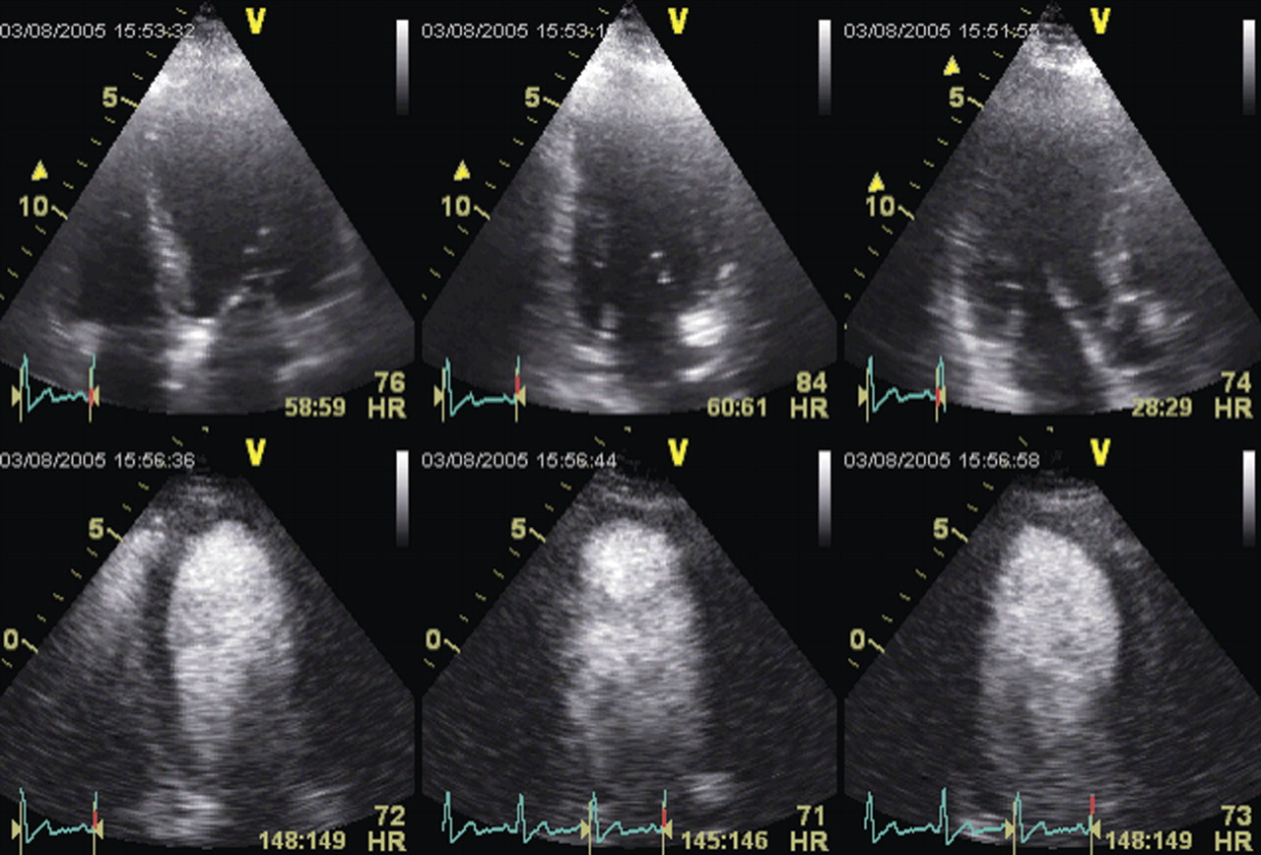

Slide 38
Results :
Recovery of function occurred in 38% of dysfunctional segments.
The best MCE parameter for predicting functional recovery was Peak MCI×[beta], an index of myocardial blood flow
MCE parameters of perfusion in hibernating myocardium were similar to segments with normal function and was higher than that in dysfunctional myocardium without recovery of function
MCE parameters were higher in segments with contractile reserve and Tl²⁰¹ uptake >60% and identified viable segments without contractile reserve by DE.

Slide 39
Single Photon Emission Computed Tomography

Slide 40
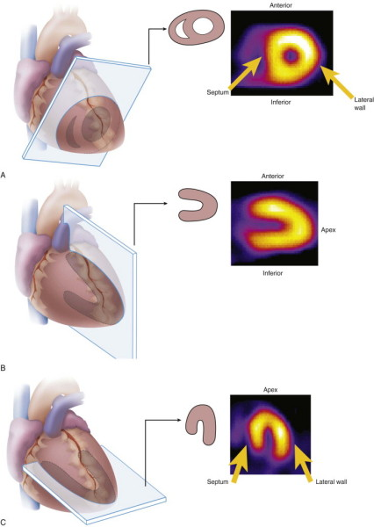
SA
VLA
STANDARD SPECT IMAGING DISPLAY
HLA

Slide 41
SPECT
SPECT requires injection of a gamma-emitting radioisotope
Thallium-201 and Technetium Tc 99m–Labelled Tracers are the commonly used radionuclides
²⁰¹Tl is a monovalent cation with biologic properties similar to those of potassium (major intracellular cation in muscle and is virtually absent in scar tissue ) →²⁰¹Tl is a well-suited radionuclide for differentiation of normal and ischemic myocardium from scarred myocardium.
The initial myocardial uptake early after intravenous injection of thallium is proportional to regional blood flow.

Slide 42
VARIOUS SPECT MODALITIES TO IDENTIFY VIABLE MYOCARDIUM

Slide 43
²⁰¹Tl stress redistribution
The uptake of ²⁰¹Tl is an energy-dependent process requiring intact cell membrane integrity, and the presence of ²⁰¹Tl implies preserved myocyte cellular viability.
Imaging is done-
1) Immediately following stress, with either exercise or pharmacologically induced coronary hyperemia with dipyridamole or adenosine
and
2) After 3–4 hr redistribution of Tl-201

Slide 44
INTERPRETATION
Defects on post-stress images, may “fill in” by the time the rest-redistribution images are acquired, indicating viability.
A defect that persists and appears again on the 3–4 hr images (i.e., a fixed-defect) may be due to:
(1) markedly reduced regional perfusion,
(2) impaired cellular membrane integrity, inadequate for the active sequestration of the tracer into the cell,
(3) cell death (acute infarction), or
(4) scar tissue.
Thus, fixed-defects on 3– 4 hr redistribution images may represent only severely hypoperfused—and not necessarily infarcted tissue

Slide 45
INTERPRETATION
Late redistribution images
Acquire a third set of images at 24 hours
This would allow for redistribution of the tracer to very-ischemic (yet viable) tissue
It has been shown that 22% of fixed defects (at early redistribution imaging) demonstrate normal Tl-201 uptake at later redistribution.
This may indicate a poorly perfused, yet viable region

Slide 46
²⁰¹Tl reinjection
This may be necessary because redistribution depends on the continued delivery of the tracer over the 3–4 hr period.
If the blood concentration of Tl- 201 decreases to a great extent, there may be insufficient delivery of the tracer and the defect may not fill-in during redistribution imaging.
The second injection of thallium with delayed imaging will give the myocytes with reduced perfusion the greatest opportunity to sequester thallium.

Slide 47
^{99m}Tc-sestamibi and tetrofosmin
They do not share the redistribution properties of ²⁰¹Tl
BUT their characteristics for predicting improvement in regional function after revascularization appear to be similar

Slide 48
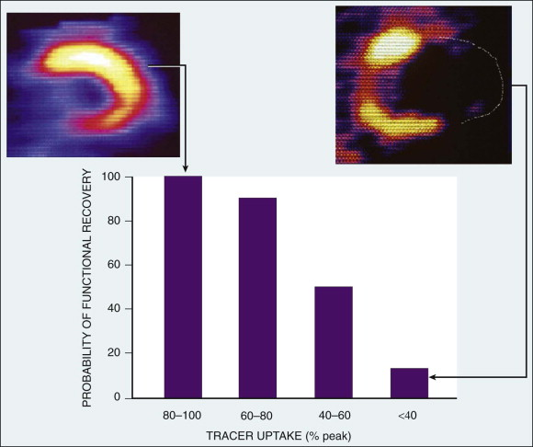
Relation between tracer uptake in a dysfunctional territory and the subsequent probability of functional recovery after revascularization.
Modified from Bonow RO: Assessment of myocardial viability with thallium-201

Slide 49
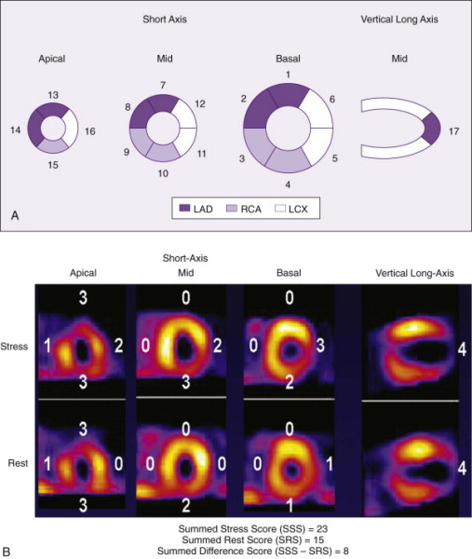
→ Fixed defect
Severe apical defect
Basal and mid inferior and lateral wall defect
→Reversible

Slide 50
The impact of viability assessment using myocardial perfusion imaging on patient management and outcome.
Hage FG et al J Nucl Cardiol. 2010 Jun;17(3):378-89. Epub 2010 Feb 26.
They studied 246 consecutive ICM patients with rest-redistribution gated SPECT thallium-201 MPI.
Size and severity of perfusion defects were assessed by automated method.
Regions with <50% activity vs normal were considered nonviable

Slide 51
RESULTS:
Of the 246 patients, 37% underwent CR within 3 months of MPI.
Independent predictors of CR included chest pains (OR 2.74) and rest-delayed transient ischemic dilatation (OR 4.49), while a prior history of CR or ventricular arrhythmias favored Medical therapy.
The cohort was followed-up for 41 +/- 30 m
Survival was better with CR than MT (P < .0001).
For CR, survival was better for those with a smaller area of nonviable myocardium (risk of death increased by 5%/1% increase in size of nonviable myocardium, P = .009) but this was not seen in MT.
CR had a mortality advantage over MT when the area of nonviable myocardium was <or=20% LV but not larger.

Slide 52
Positron emission tomography

Slide 53
MECHANISM
Glucose utilization is evaluated with FDG and regional perfusion assessed with N13-ammonia, rubidium-82, or O15- labeled water.
FDG is transported into the cell by the same sarcolemmal carrier as glucose, where it is phosphorylated to FDG-6-phosphate by the enzyme, hexokinase.
This unidirectional reaction results in the intracellular accumulation of FDG-6-phosphate.
Since FDG does not undergo further metabolism, its uptake is proportional to the overall rate of trans-sarcolemmal transport and hexokinase phosphorylation.

Slide 54
MECHANISM
fatty acid oxidation stops shortly after the onset of severe ischemia and ischemic myocytes will derive energy from stored glycogen through anaerobic glycolysis.
After glycogen stores have been depleted, the ischemic myocyte efficiently use circulating glucose.
Under conditions of extremely diminished glucose delivery, sarcolemmal glucose transporters are up-regulated to allow for increased uptake of this substrate.

Slide 55
INTERPRETATION
As there should be no uptake of glucose by infarcted myocardium—which is metabolically inert—nonviable myocardium will appear as a region of low-FDG concentration in such images.
In areas of reversibly injured myocardium, glucose utilization is normal and even above normal
Thus, stunned or hibernating myocardium may be indistinguishable from normal tissue in an FDG PET image.

Slide 56
PET perfusion imaging
Estimations of myocardial perfusion have been performed with ¹³NH3 and H2¹⁵O
Initial uptake is in proportion to myocardial blood flow but the retention of 13NH3 depends on the metabolic integrity of the myocytes.
Thus, late-distribution ¹³NH3 PET images is useful in the assessment of myocardial viability
PET imaging with 82Rb→ does not need a cyclotron facility.
Late-distribution 82Rb images reflect myocardial viability as the successful uptake of 82Rb depends on an intact myocyte membrane (a functional Na/K ATPase pump)

Slide 57
The Combined Value of Perfusion/Metabolism PET
The combination of perfusion PET and FDG PET has long been considered the gold-standard for the identification of hibernating myocardium.
The identification of a region with low perfusion reserve by 13NH3 despite normal FDG uptake is highly predictive of both functional recovery and survival post revascularization.

Slide 58
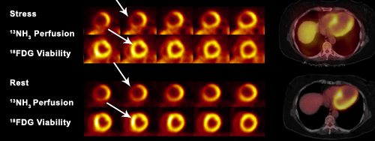
PET•CT cardiac perfusion and viability mismatch study

Slide 59
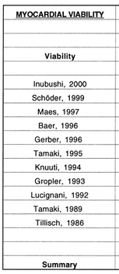
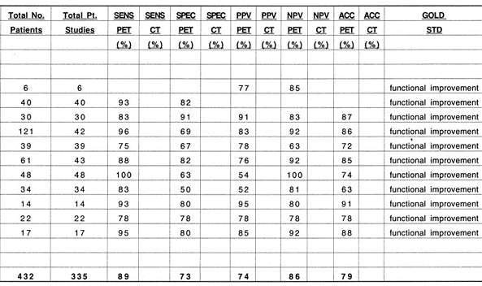
FDG PET in Myocardial Viability- various studies
combined sensitivity and specificity of 88 and 73%,

Slide 60
SPECT VS FDG PET
Brunken et al published data from a comparison of tomographic thallium images with PET images; 47% of the irreversible thallium defects were identified as viable on PET images
Circulation. Nov 1992;86(5):1357-69.
Tamaki et al subsequently confirmed these findings in 2 comparative studies of SPECT and PET in which 38-42% of the irreversible thallium defects had enhanced FDG uptake suggestive of viable myocardium.
Am J Cardiol. Oct 15 1989;64(14):860-5

Slide 61
Magnetic resonance Imaging

Slide 62
Magnetic resonance imaging
Three techniques are being used:
1.Resting MRI to measure end diastolic wall thickness.
2. Dobutamine MRI to evaluate contractile reserve.
3. Contrast enhanced MRI to detect extent and transmurality of scar tissue.

Slide 63
Resting MRI
End diastolic wall thickness < 6 mm represent transmural scar.
Dobutamine MRI
Evaluate contractile reserve.
Increased resolution of MRI avoid subjective variation of echo.
Has sensitivity of 89% & specificity of 94% to predict improvement after revascularization.
Contrast enhanced MRI
Allows precise detection of scar tissue.
Extent & transmurality of scar can be assessed.
Can detect subendocardial scar.
Similar to FDG PET in detecting scar.

Slide 64
Contractile reserve (DS MRI)
Compared to SPECT with both thallium and Tc sestamibi DS MRI is less sensitive but more specific with respect to recovery of contractile function after revascularisation
Sensitivity / Specificity :
50 / 81% for MRI
76 and 44% for SPECT thallium
66 and 49% for SPECT Tc
Compared PET (gold standard), sensitivity and specificity of dobutamine MRI for the diagnosis of myocardial viability have resulted to be 81 and 95%.

Slide 65
DE MRI
Allows direct or indirect assessment of viability
Infarct characterization
In a study, presence of Microvascular obstruction, Increased LVEDV and Impaired LVEF in MRI are found to be independent predictors of adverse events.
Three patterns of enhanced signal hyperintensity:
1) Early hypointensity → No late hyperintensity (hypo),
2) early Hyperintensity → late hyperintensity (hyper);
3)early hypointensity → late hyperintensity (comb).

Slide 66
Type I pattern (hypo)
Indicated diffuse microvascular damage
Severe myocardial damage / Myocardial necrosis
Poor functional recovery after revascularisation

Slide 67
Recovery after Revasc. Depends on transmural extension
Highly probable < 25%,
intermediate 25 - 75%,
Very low / null > 75%
Hyperintensities restricted to Subendocardial area will recover contractility better

Slide 68
DE MRI compared to DSE
Nelson et al: TEI by DE MRI is inversly related to contractile reserve by DSE
Half of all segments which were fully viable by DE MRI had absence of contractile reserve.
Due to tethering of viable regions to scar regions, myocyte cellular adaptations that impair dobutamine response, and absence of coronary flow reserve in chronically hypoperfused regions.

Slide 69
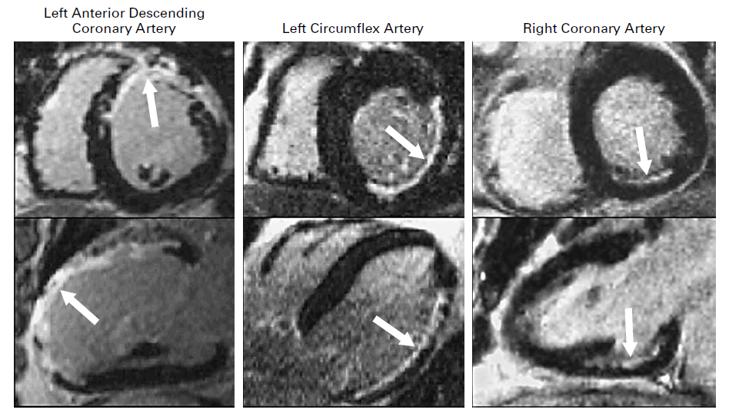

Slide 70
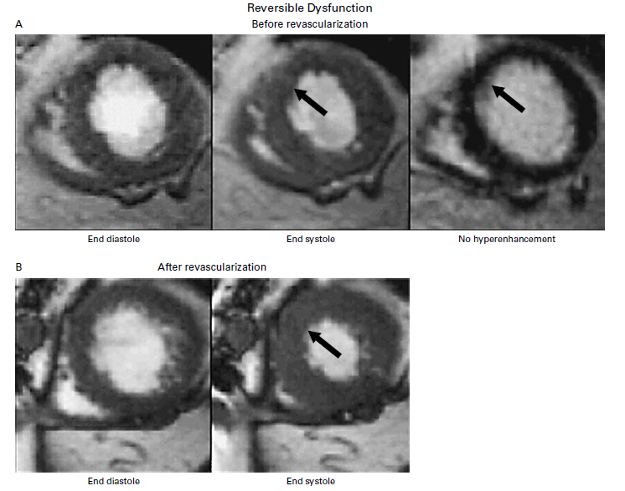
AKINETIC SEGMENT
NO SCAR ON MRI
VIABLE
SEGMENT BECAME FUNCTIONAL POST REVASCULARISATION
REVERSIBLE DYSFUNCTION
Notes:
The patient with reversible dysfunction had severe hypokinesia of the anteroseptal wall (arrows), and this area was not hyperenhanced
before revascularization. The contractility of the wall improved after revascularization. The patient with irreversible dysfunction
had akinesia of the anterolateral wall (arrows), and this area was hyperenhanced before revascularization. The contractility of
the wall did not improve after revascularization.

Slide 71
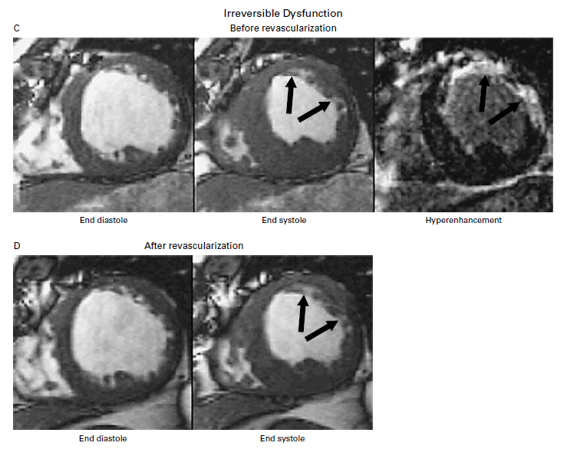
AKINETIC SEGMENT
SCAR ON MRI
NON VIABLE
SCAR AND AKINESIS WAS PERSISTENT POST REVASCULARISATION
IRREVERSIBLE DYSFUNCTION

Slide 72
ORIGINAL ARTICLE
The Use of Contrast-Enhanced Magnetic Resonance Imaging to Identify Reversible Myocardial Dysfunction
Raymond J. Kim, M.D., Edwin Wu, M.D., Allen Rafael, M.D., Enn-Ling Chen, Ph.D., Michele A. Parker, M.S., Orlando Simonetti, Ph.D., Francis J. Klocke, M.D., Robert O. Bonow, M.D., and Robert M. Judd, Ph.D.
N Engl J Med 2000; 343:1445-1453
Gadolinium-enhanced MRI was performed in 50 patients with ventricular dysfunction before they underwent surgical or percutaneous revascularization.
The transmural extent of hyperenhanced regions was postulated to represent the transmural extent of nonviable myocardium.
The extent of regional contractility at the same locations was determined by cine
MRI before and after revascularization in 41 patients.

Slide 73
RESULTS
An absence of delayed enhancement in segments that exhibit abnormal contractility has a positive predictive value of 78% for recovery after revascularization.
A <25% delayed enhancement has a positive predictive value of 71%.
The percentage of the left ventricle that was both dysfunctional
and not hyperenhanced before revascularization was strongly related to the degree of improvement in the global mean wall-motion score (P<0.001) and
the ejection fraction (P<0.001) after revascularization.

Slide 74
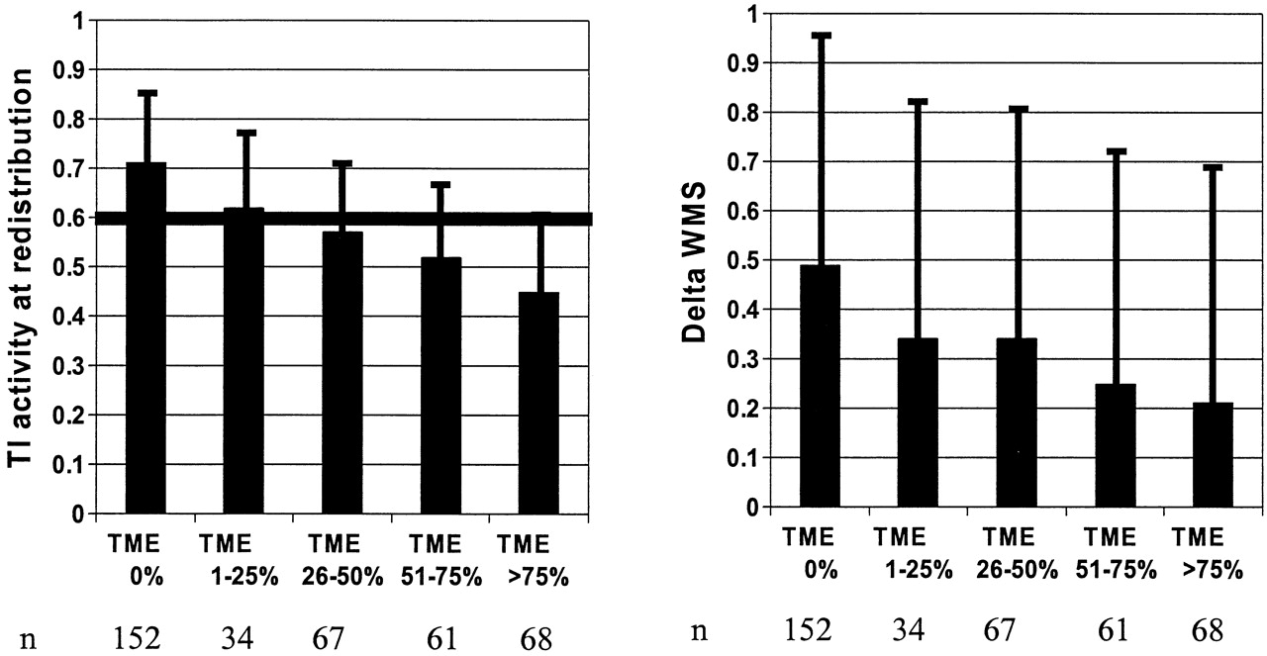
Relationship between transmual extent of scar (TES) and thallium (Tl) activity at late redistribution (left) and increase in wall motion score (WMS) with low-dose dobutamine (right)

Slide 75
Accuracy of currently available techniques for prediction of functional recovery after revascularization in patients with left ventricular dysfunction due to chronic coronary artery disease: comparison of pooled data
METHODS
A systematic review of all reports on prediction of functional recovery after revascularization in patients with chronic coronary artery disease
MODALITIES : Thallium-201 (Tl-201) stress-redistribution-reinjection, Tl-201 rest-redistribution, fluorine-18 fluorodeoxyglucose with positron emission tomography, technetium-99m sestamibi imaging and low dose dobutamine echocardiography
RESULTS:
Sensitivity for predicting regional functional recovery after revascularization was high for all techniques. The specificity of both Tl-201 protocols was significantly lower (p < 0.05) and LDDE significantly higher (p < 0.01) than that of the other techniques
CONCLUSIONS
Although all techniques accurately identify segments with improved contractile function after revascularization, the Tl-201 protocols may overestimate functional recovery. The evidence available thus far indicates that LDDE appears to have the highest predictive accuracy.
J Am Coll Cardiol, 1997; 30:1451-1460

Slide 76
Commonly Used Noninvasive Testing Modalities to Predict Regional Functional Improvement
MODALITY | SENSITIVITY (%) MEAN (95% CI) | SPECIFICITY (%) MEAN (95% CI)
Dobutamine echocardiography | 76 (72-80) | 81 (77-84)
Delayed enhancement by MRI | 97 (91-100) | 68 (51-85)
FDG PET | 89 (85-93) | 57 (51-63)
SPECT | 89 (84-93) | 68 (61-75)
Circulation 117:103, 2008.

Slide 77
ACC/AHA/ASNC Guidelines
Recommendations for the Use of Radionuclide Techniques to Assess Myocardial Viability
J Am Coll Cardiol, 2003; 42:1318-1333
Indication | Test | Class | Level of Evidence
1. Predicting improvement in regional and global LV function after revascularization | Stress/redistribution/reinjection ²⁰¹Tl | I | B
 |  | I | B
 | Perfusion plus PET FDG imaging | I | B
 | Resting sestamibi imaging | I | B
 | Gated SPECT sestamibi imaging | IIa | B
 | Late ²⁰¹Tl redistribution imaging (after stress) | IIb | B
 | Dobutamine RNA | IIb | C
 | Postexercise RNA | IIb | C
 | Postnitroglycerin RNA | IIb | C
2. Predicting improvement in heart failure symptoms after revascularization. | Perfusion plus PET FDG imaging | IIa | B
3. Predicting improvement in natural history after revascularization | ²⁰¹Tl imaging (rest-redistribution and stress/redistribution/reinjection) | I | B
 | Perfusion plus PET FDG imaging | I | B

Slide 78
MR Coronary angiography
Useful in imaging Proximal and medium segments of major epicardial coronary arteries
Useful in identifying the origin and course of anomalous coronaries
Useful in assessing Bypass graft patencies (both Venous and Arterial)
Useful in Plaque characterisation of coronary vessel wall

Slide 79
Characterisation of Vessel Wall
Tissues rich in Protons will have hyperintense signal.
Calcifications have a low concentration of protons and appear hypointense.
The lipid plaques have both a short T1 and a short T2 and will be hyperintense in T1-weighted images
Fibrous plaques have a quite similar signal intensity in T1- and T2-weighted images

Slide 80
MR Coronary angiography
Limitations:
small arterial size (<5mm)
tortuosity
complex anatomy
cardiac and respiratory motion
Mainly for assessing Proximal diameter stenosis and to rule out multivessel CAD
At present assessment for surgical planning is difficult

Slide 81
3D MR angio

Slide 82
3D MRA of LIMA

Slide 83
Feasibility of MR coronary angio

Slide 84
Impact of Revascularization on LV Function
Studies shows LV ejection fraction improves significantly (ie ≥ 5%) after revascularization in 60% of patients (range 38% to 88%).
To predict 5% improvement in LVEF, at least 25% of LV should be viable using DSE and ≈38% using conventional nuclear medicine and PET.
In dyskinetic and akinetic segments, absence of scar or a transmural extension of scar of <25% have PPV of 88% and NPV 89% for functional recovery.

Slide 85
Treatment and Survival Rates
Meta-analysis that pooled data of 3,088 pts from 24 studies demonstrated improved survival after revascularization in pts with hibernation.
Revascularization resulted in 79.6% reduction in mortality (16% vs 3.2%)
In absence of hibernation, no significant difference in mortality with revascularization (7.7% vs 6.2%).

Slide 86
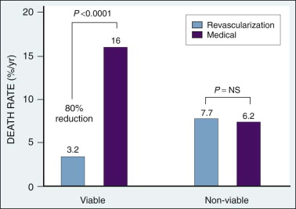
Meta-analysis demonstrating outcome of patients with ischemic left ventricular dysfunction after viability testing
J Am Coll Cardiol 39:1151, 2002

Slide 88
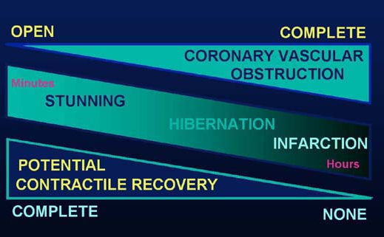
Summary
Stunning and hibernation are 2 causes for LV dysfunction.
Both conditions imply presence of viable myocardium and are reversible.

Slide 90
THANK YOU

